Slide 1
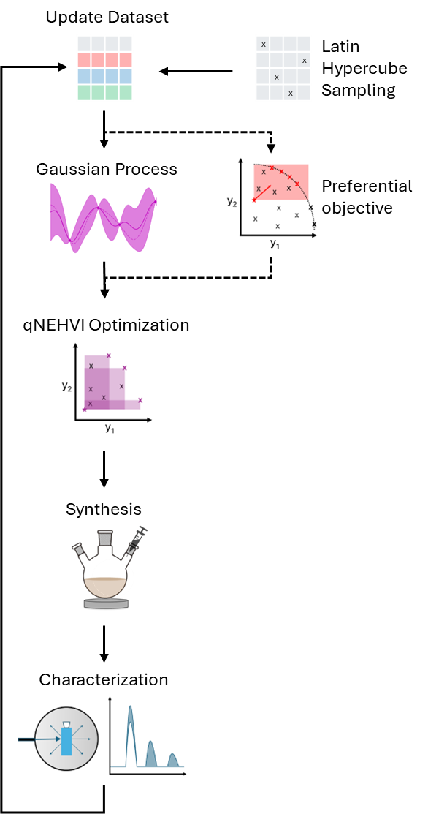
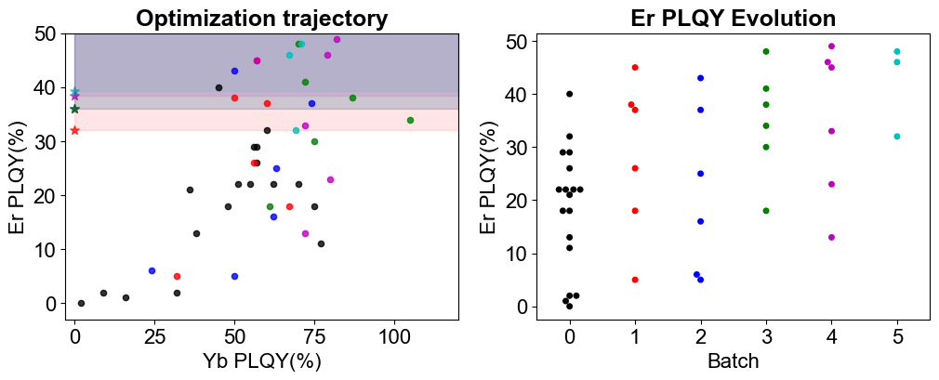
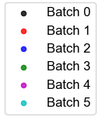
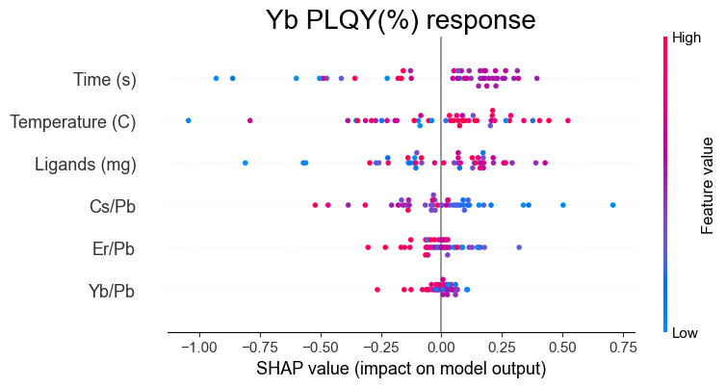
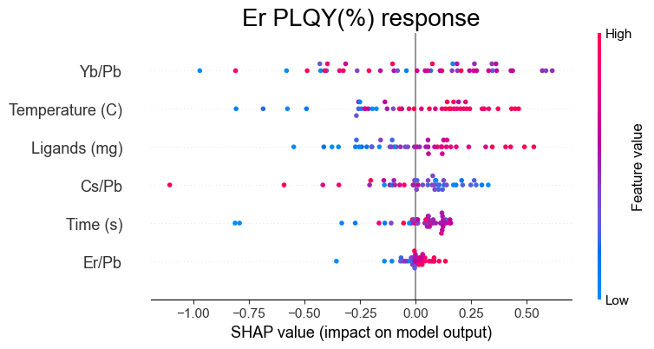
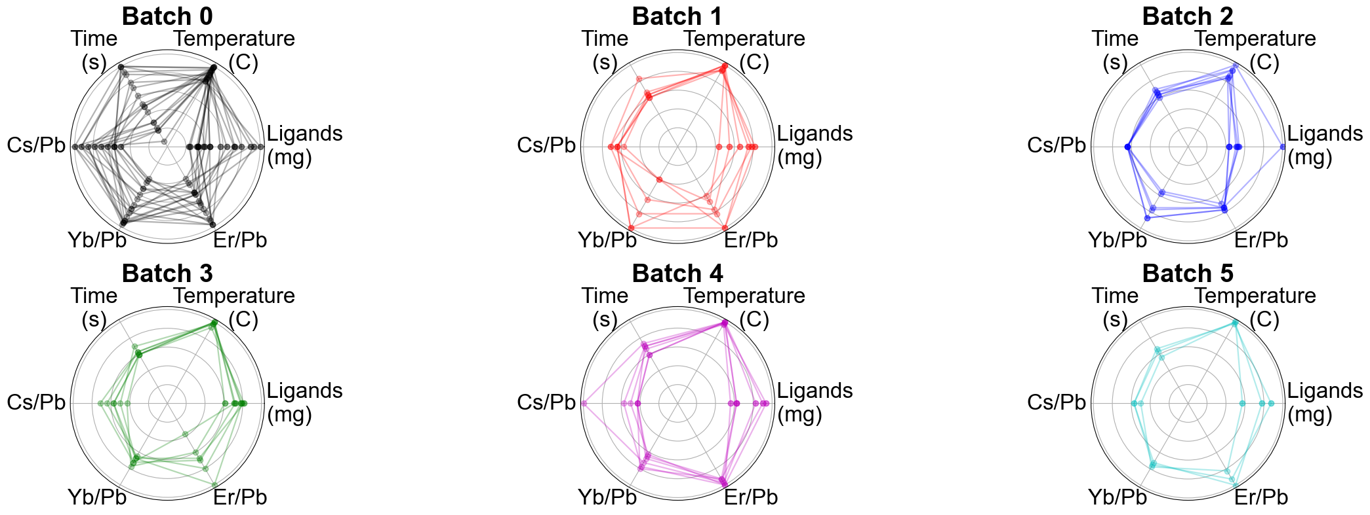
a)
b)
c)
d)

Slide 2
Caption
Figure 3. Optimization of Yb/Er co-doped CsPbCl 3 NCs with DPGAM ligands. a) Active learning workﬂow for simultaneously optimizing both Yb and Er PLQY using a preferential reference point. b) Objective space of all experiments in optimization campaign (including updated reference point) and improvement in Er PLQY across batches, showing convergence by batch 4. c) SHAP analysis of both Yb and Er PLQY from GP model trained on all data points, showing different variable relationships for both. d) Polar plots of all 6 variables across batches, showing convergence towards specific input values.

Slide 3
Write up
We proceed to optimize for PLQY of Yb/Er co-doped CsPbCl3 NCs using Bayesian Optimization (BO) to iteratively learn and improve PLQY. Due to the competing relationship of Yb and Eb emittance, we treat this as a multi-objective optimization problem and implement a similar workflow to that of Velasco et al [1] as seen in Figure 3a, taking a preference for Er PLQY with an adaptive reference point (details found in methods section). We initiated with 18 samples using Latin Hypercube sampling, followed by 4 batches with 6 samples each and a final 5th batch with 3 samples, shown in Figure 3b.
We opt to perform SHAP (SHapley Additive exPlanations) analysis of the data in Figure 3c using a Gaussian Process (GP) trained on the entirety of the data after the campaign. We propose that Yb PLQY is NC quality dependent since the dominating factors are growth factors temperature, time and ligand amount. Correspondingly, Er PLQY is dependent on the energy levels between states, by carefully controlling for composition, most notably Yb/Pb ratio. This is inline with our hypothesis that high PLQY is predicated on high true quantum cutting first before stepping to Er energy state. The distribution of input values are reported in Figure 3d using polar plots, which show convergence towards best performance at around 0.8 Cs/Pb, 3.0 Yb/Pb and 3.7 Er/Pb.
1. https://doi.org/10.1039/D3DD00255A

Slide 4
Methods
Initialization with first 18 samples is done using Latin Hypercube sampling implemented in scikit-optimize [cite]. The variables are rounded down to 1 decimal for all, except for temperature and time which is rounded down to nearest integer. The BO workflow relies on BoTorch [cite], using default GP kernel Matern 5/2 for surrogate model, trained independently for each objective. The acquisition function is qNEHVI [cite Velasco et al], with an adaptive reference point set at fixed 0% Yb PLQY and taking 0.8 * current best Er PLQY. Optimization is performed by executing optimize_acqf function in BoTorch library. Details and code can be found in https://github.com/andrelowky/Optimization-of-Yb-Er-co-doped-CsPbCl3-NCs-with-DGPAM-ligands.

Slide 5
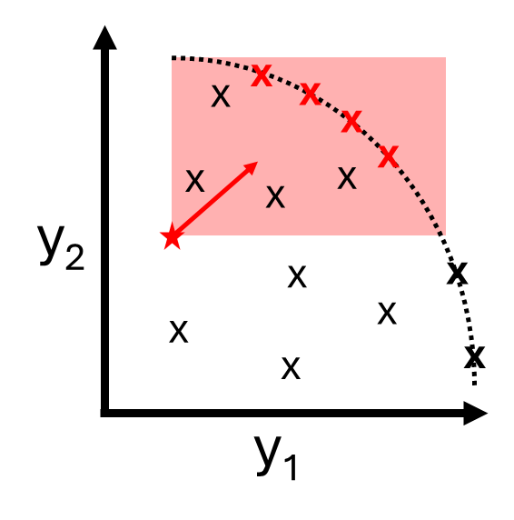
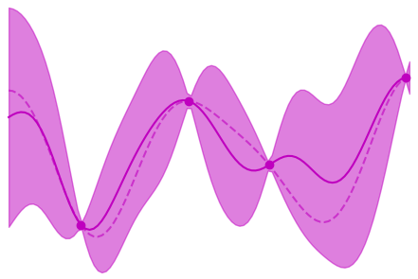
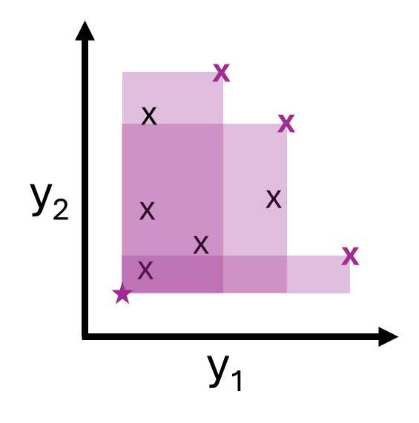
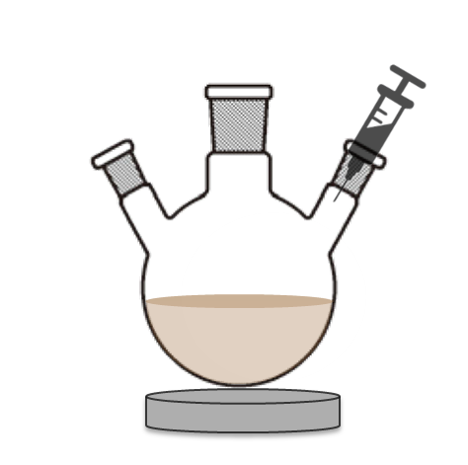
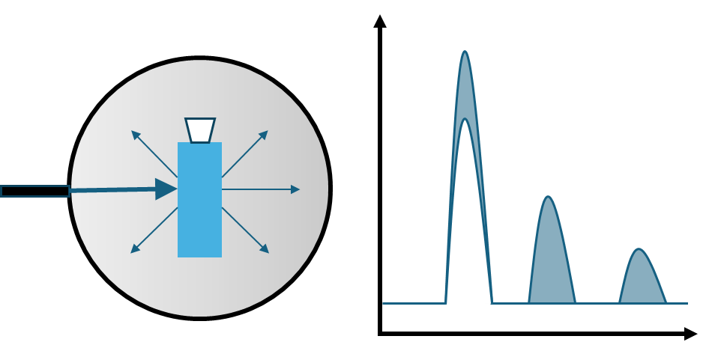
Update Dataset
x
 |  |  | x
 | x
 |  | x
Latin Hypercube Sampling
Gaussian Process
Preferential objective
qNEHVI Optimization
Synthesis
Characterization

Slide 6
x
x
x
x
x
x
x
x
x
x
x
x
x
x
y₂
x₁
x
x
x
x
x
x
x
x
x
x
x
x
x
x
x
y₁
x₂
y₂
x
x
x
x
x
y₁

Slide 7



